Slide 1
Win8 Single Sign On: Brief

Slide 2
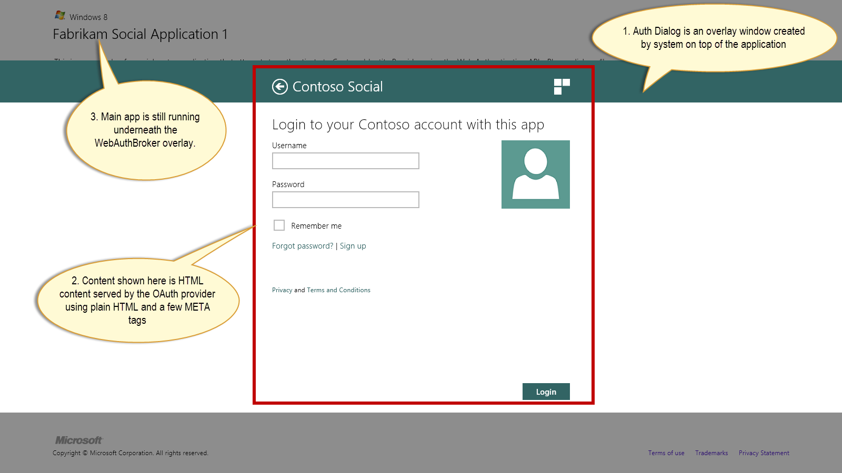
How does Authentation using the WebAuth Broker look like

Slide 3
OS level separation of App + WebAuthBroker

Slide 4
How it really works
2. Please send Cookie. Validate AppId+ms-app redirect pairing. Also please do
ms-app://SID redirect
Oauth Provider
App 1
App 2
3. Cookie Sent,
redirect made to
ms-app://sid
1. Invoke login
In SSO Mode.
Supply AppId
Registered with
Contoso
5. Login
Successful
6. Invoke Login
in SSO Mode,
Supply AppId
Registered with
Contoso
9. You are logged in
8. Please allow login
Identified by cookie and
Contoso AppId,
also redirect to
ms-app://sid if Appid and
Redirect URL binding is
Correct.
Web Auth Broker
4. Cookie Saved
7. Pick cookie from OS
Cookie Jar Held by OS
The Oauth Cookie

Slide 5
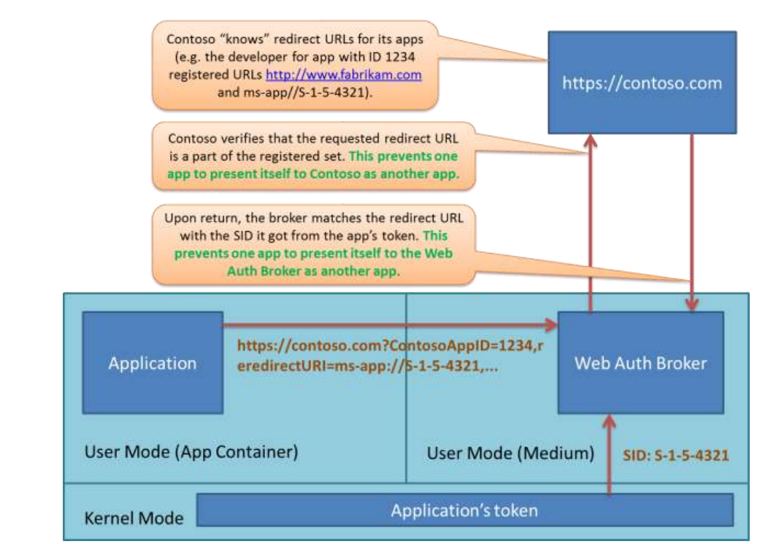
A bit more detail

